Slide 1

Spotify Streaming Trends and Insights
A Comprehensive Analysis of Spotify Streaming Data By – Suraj Kashid
Batch - MB25

Slide 2
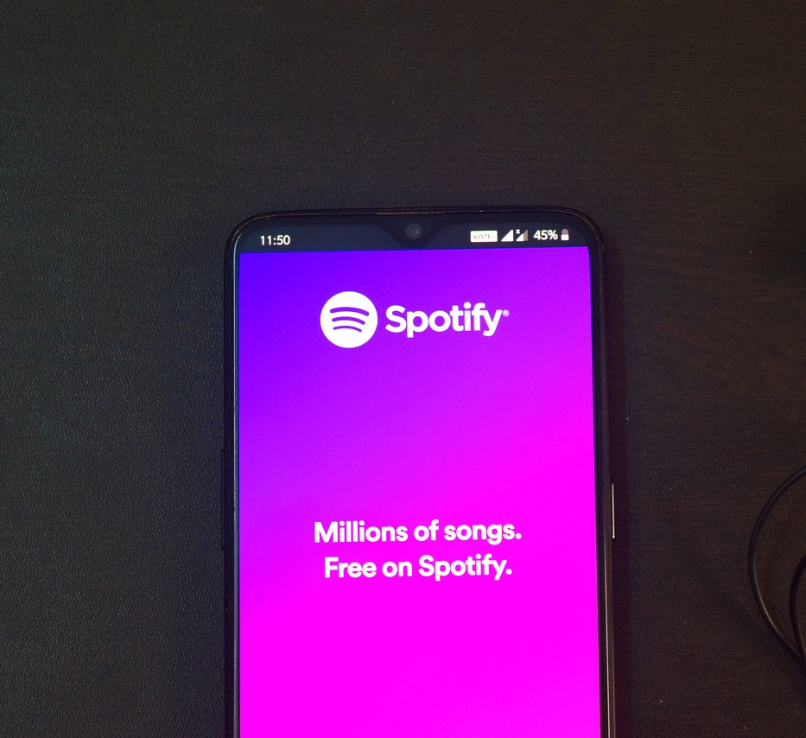
Introduction
Objective :
To analyze Spotify streaming data to identify key trends in the music industry.
To provide actionable insights for creating effective advertisements on Spotify.
Overview:
Briefly mention the sections covered in the presentation.

Slide 3
Data Source and Methodology
Data Source: Spotify streaming data was provided by the guvi team .
Data Cleaning: The steps taken to clean and preprocess the data such as Normalization.
Tools Used: The tools used for analysis and visualization (e.g., Tableau, Excel).

Slide 4
Key Performance Indicators (KPIs)
Total Streams: The total number of streams for each track.
Most Popular Artists: Top artists based on total streams.
Most Popular Tracks: Top tracks based on total streams.
Streaming Trends Over Time: How streaming activity has changed over time.
Popularity by Country: Distribution of streams across different countries.

Slide 5
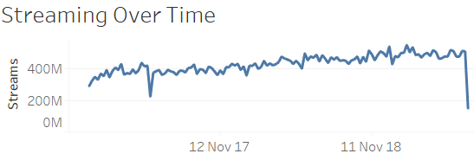

Total Streams
Bar chart visualization showing total streams for the top tracks.
Insights derived from the visualization
Top Tracks Lead with High Numbers:
1. Observation: The top tracks have significantly higher total streams compared to others.
2. Insight: Popular tracks capture a large share of listener engagement, indicating their strong appeal and frequent play counts.

Slide 6
Impact of New Releases:
1. Observation: Recently released tracks show higher streaming numbers shortly after their release.
2. Insight: New releases tend to attract more immediate attention, suggesting that promotional efforts around launch periods can boost streaming numbers.
Genre Trends:
Observation: Certain genres dominate the top tracks, reflecting listener preferences.
Insight: Understanding genre popularity can help in crafting targeted advertising and playlist strategies.
Streaming Peaks:
Observation: Some tracks experience spikes in streams during specific periods (e.g., holidays, viral moments).
Insight: Identifying peak times for popular tracks can guide timing for promotional activities and targeted ad placements.
Artist Influence:
Observation: Tracks by top artists consistently have high streaming numbers.
Insight: Artist popularity plays a significant role in streaming volume, highlighting the importance of artist promotion in driving total streams.
Conclusion: The total streams data reveals that popular tracks dominate listener engagement and that new releases, genre trends, and artist influence play crucial roles in streaming numbers. Leveraging these insights can optimize advertising strategies and maximize impact on Spotify.

Slide 7
Most Popular Artists
Bar chart visualization showing total streams for the top artists
Insights Derived:
Post Malone and Drake Dominate:
Observation: Post Malone and Drake are the top two artists with over 1.5 billion streams each.
Insight: Their consistent release of hit songs and strong fan base contribute significantly to their high streaming numbers.
Diverse Genres Represented:
Observation: The top artists list includes a variety of genres from pop (Ed Sheeran) to rap (XXXTentacion).
Insight: This diversity indicates that Spotify users have broad musical tastes and that popular artists come from a wide range of musical styles.
International Reach:
Observation: Artists like Ed Sheeran and Billie Eilish have significant streams from multiple countries.
Insight: Their global appeal highlights the importance of international marketing and touring to boost streaming numbers.

Slide 8
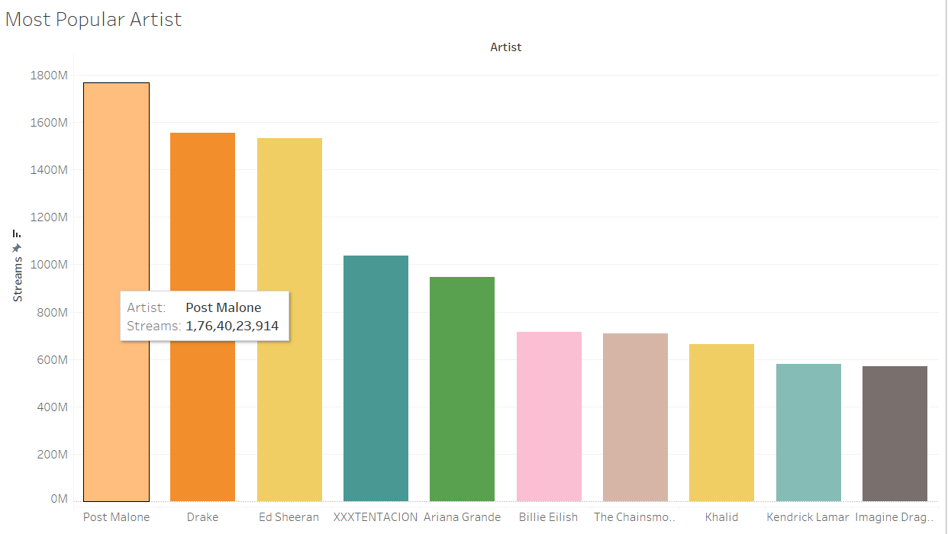
4. Emerging Artists Gaining Traction:
Observation: Newer artists like Khalid and XXXTentacion are also among the top, despite being relatively new to the industry.
Insight: Indicates a shift in music consumption towards newer artists, suggesting that listeners are open to discovering and supporting emerging talent.
5. Strategic Collaborations:
Observation: Artists who frequently collaborate with others (e.g., Khalid, who has many features) tend to have higher streaming numbers.
Insight: Collaborations can be a strategic move to expand an artist’s reach and attract new listeners from different fan bases.

Slide 9
Most Popular Tracks
Insights Derived:
Top Hits Dominate Streams:
Observation: Tracks like "Despacito - Remix" and "God's Plan" have exceptionally high stream counts.
Insight: These songs have achieved widespread popularity and dominate the streaming charts.
Longevity of Popular Tracks:
Observation: Many of the top tracks maintain high streaming numbers over long periods.
Insight: Popular songs continue to attract listeners even after their initial release, indicating enduring appeal.
Impact of Collaborations:
Observation: Tracks featuring multiple popular artists, such as "Despacito - Remix" (Luis Fonsi, Daddy Yankee, Justin Bieber), have higher streams.
Insight: Collaborations can significantly boost a track's popularity by combining fan bases.
Influence of Viral Trends:
Observation: Songs like "In My Feelings" became viral hits, reflected in their high streaming numbers.
Insight: Viral trends and challenges on social media platforms can drive massive increases in streams.
Regional Popularity:
Observation: Some tracks have high streams in specific regions or countries.
Insight: Targeted marketing and cultural relevance play a key role in a track’s success in particular areas.
Conclusion: The analysis of the most popular tracks reveals that massive hits, enduring appeal, strategic collaborations, viral trends, and regional popularity are key factors driving high streaming numbers. These insights can help shape effective music marketing and promotion strategies to maximize a track’s reach and impact.

Slide 10
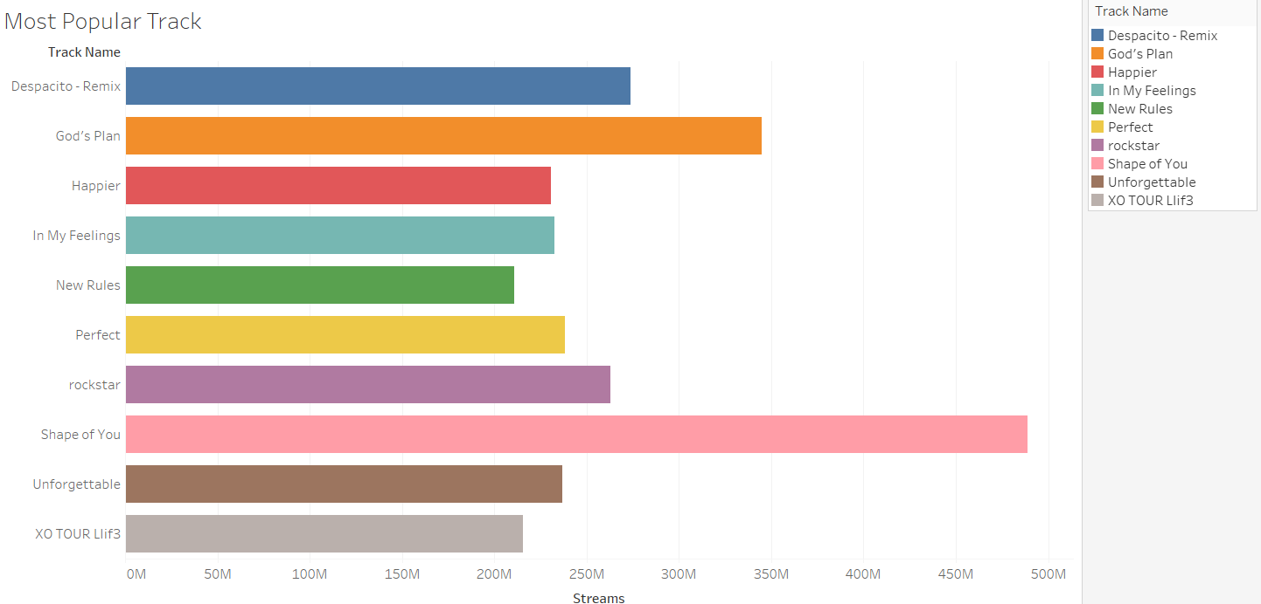

Slide 11
Popularity by Country
Insights Derived:
Global Reach of Top Tracks:
Observation: Popular tracks have a wide geographic distribution, with significant streams from multiple countries.
Insight: This indicates a global appeal and the ability to attract listeners from diverse regions.
Regional Concentrations:
Observation: Certain tracks have particularly high streams in specific countries, such as the United States, Brazil, and Germany.
Insight: Focused regional marketing and cultural relevance can drive higher streams in these areas.
Emerging Markets:
Observation: Emerging markets like India and Mexico show increasing streaming numbers.
Insight: These regions present new opportunities for growth and targeted promotional efforts.
Influence of Local Artists:
Observation: Countries with local artists in the top charts, such as the Netherlands and Australia, show high streaming numbers for these artists.
Insight: Promoting local talent can boost streaming numbers within their home countries.
Seasonal Variations:
Observation: Some countries exhibit seasonal spikes in streams, possibly related to holidays, festivals, or local events.
Insight: Understanding and leveraging these seasonal trends can enhance promotional strategies and timing.

Slide 12
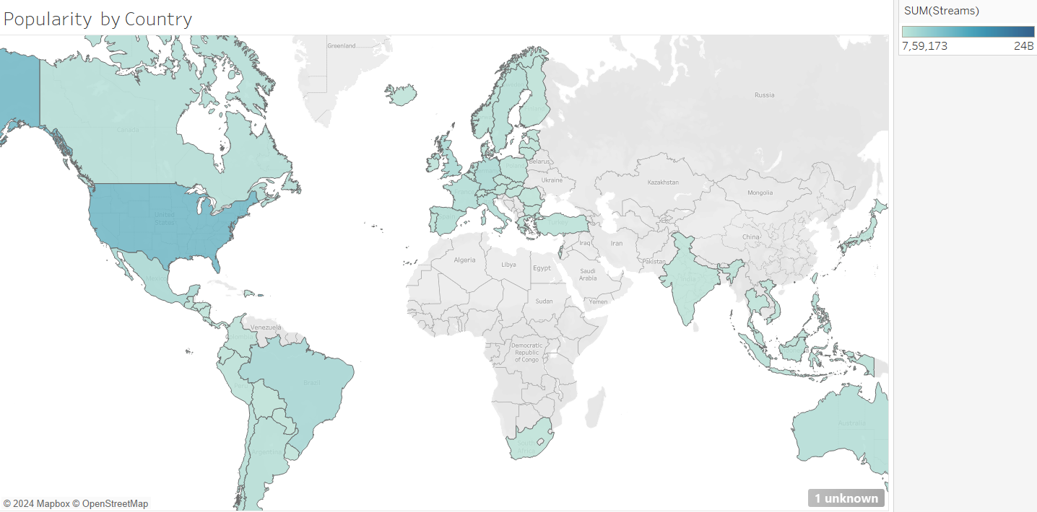
Conclusion: The analysis of streaming popularity by country highlights the importance of global reach, regional focus, emerging markets, local artist promotion, and seasonal variations in driving streaming success. These insights can inform more targeted and effective marketing strategies to maximize a track's impact across different regions.

Slide 13
Conclusion
Summary of Key Findings:
Total Streams: Identified top tracks with the highest streaming numbers, highlighting the significant impact of viral hits and collaborations.
Most Popular Artists: Post Malone, Drake, and other top artists dominate streaming charts due to their widespread appeal and consistent releases.
Streaming Trends Over Time: Observed sustained popularity of top tracks and identified spikes in streaming activity influenced by social media trends.
Popularity by Country: Highlighted the global reach of popular tracks and the importance of regional marketing efforts.

Slide 14
Impact on Marketing and Advertising Strategies:
Targeted Campaigns: Insights on popular artists and tracks can guide targeted advertising campaigns to reach specific audience segments.
Regional Focus: Understanding regional popularity allows for more effective marketing strategies tailored to different countries and cultural preferences.
Leveraging Viral Trends: Utilizing social media and viral challenges can significantly boost track visibility and streaming numbers.
Promoting Emerging Artists: Supporting new talent can capture evolving listener preferences and attract a broader audience.

Slide 15
Future Work and Potential Improvements:
Data Integration: Incorporate additional data sources, such as social media metrics and listener demographics, for a more comprehensive analysis.
Real-time Updates: Implement real-time data updates to keep the dashboard current and relevant.
Advanced Analytics: Utilize machine learning and predictive analytics to forecast trends and identify potential future hits.
User Feedback: Collect user feedback to continuously improve dashboard features and usability.

Slide 17

Thank you

